Slide 1
Unit 4 - Lesson 9
Functions Explore/Investigate

Slide 3
Unit 4 Lesson 9 - Warm Up
Prompt
In Style 1, what line of the song do you sing after line 09? What about in Style 2?
Style 2 uses fewer lines to write. Are there fewer lyrics to sing?
What are the benefits of writing a song in Style 2?

Slide 5
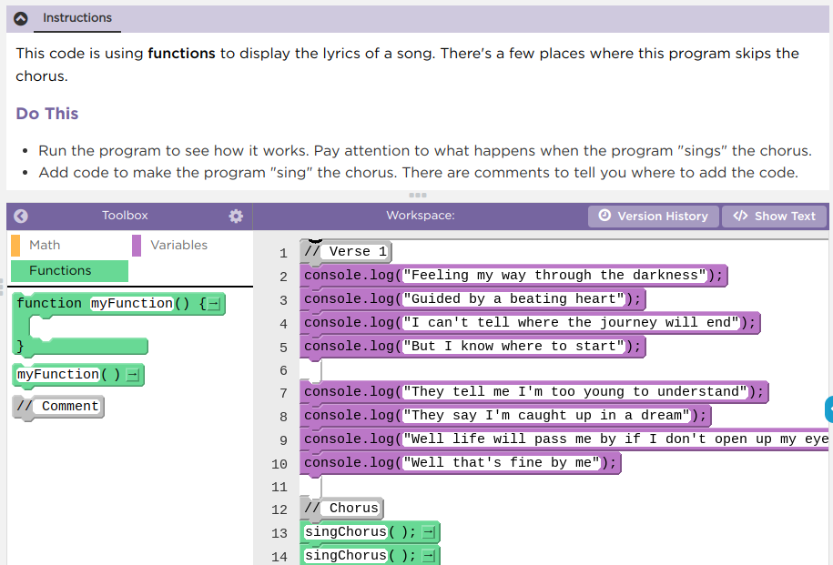
Unit 4 Lesson 9 - Activity
Functions Explore / Investigate
Do This:
Navigate to Lesson 9, Level 1 on Code Studio

Slide 6
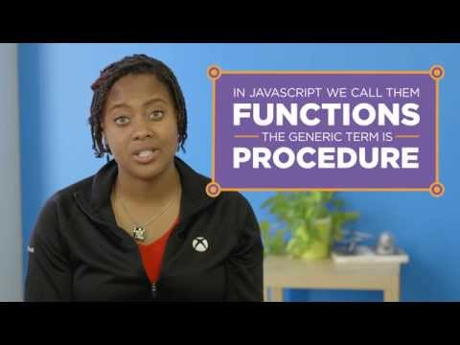
Unit 4 Lesson 9 - Activity
Stop at 1:32

Slide 7
Unit 4 Lesson 9 - Activity

Slide 8
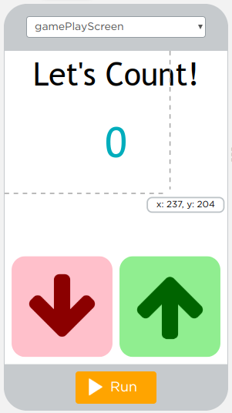
Unit 4 Lesson 9 - Activity
Level 3
On what line(s) is the updateScreen functions being declared?
On what lines is the updateScreen function being called?
How does the updateScreen function make the program easier to write and understand?

Slide 9
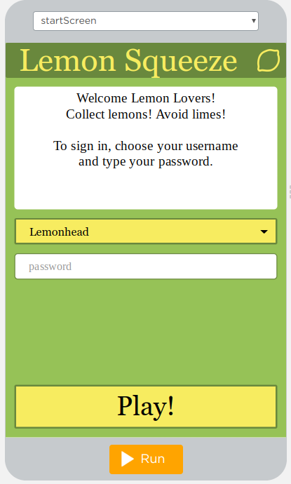
Unit 4 Lesson 9 - Activity
Level 4
How does the newly added updateScreen function help keep your code better organized or reduce the amount of repeated code?

Slide 11
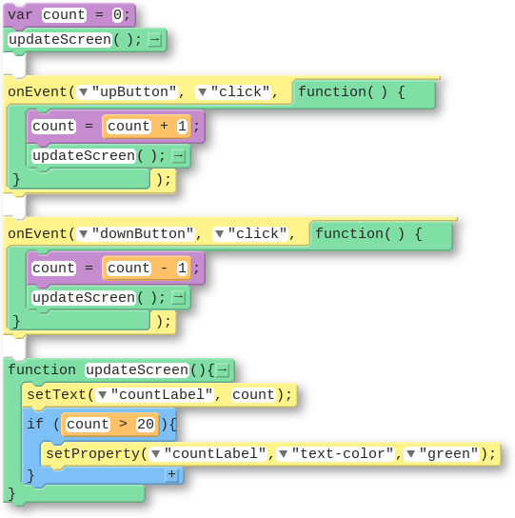
Unit 4 Lesson 9 - Wrap Up
The updateScreen() Pattern
Code (Block) | Code (Text)
 | var count = 0; updateScreen(); onEvent(“upButton”, “click”, function(){ count = count + 1; updateScreen(); }); onEvent(“downButton”, “click”, function(){ count = count - 1; updateScreen(); }); function updateScreen(){ setText(“countLabel”, count); if(count > 20){ setProperty(“countLabel”, “text-color”, “green”); } }

Slide 12
Unit 4 Lesson 9 - Wrap Up
Function: a named group of programming instructions. Also referred to as a “procedure”.
Function Call: a command that executes the code within a function

Slide 13
Unit 4 Lesson 9 - Wrap Up
Prompt:
Reflecting on today's lesson about functions:
What did you learn?
What are you uncertain about?

Slide 14
Unit 4 - Lesson 10
Functions Practice

Slide 17
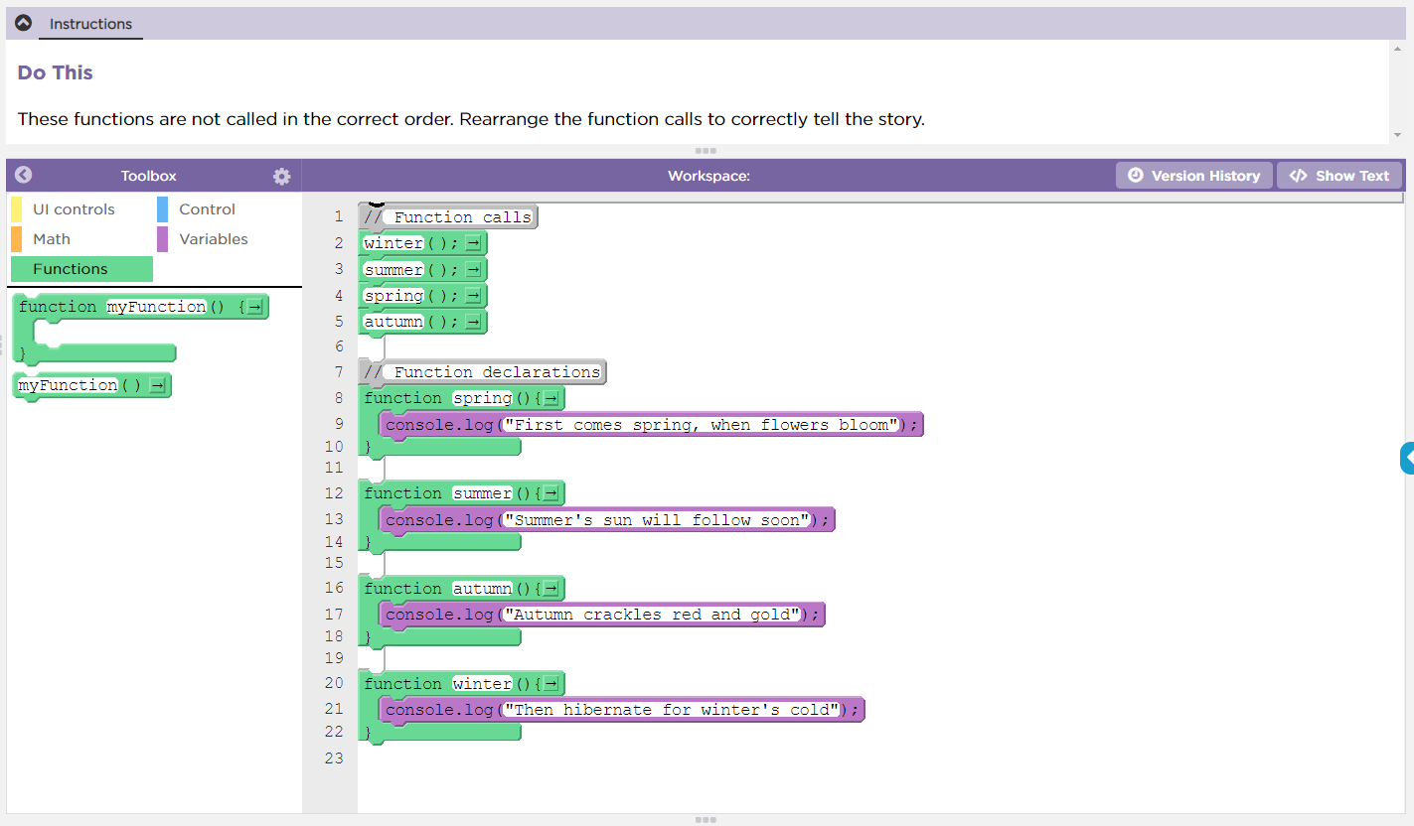
Unit 4 Lesson 10 - Activity
Functions Practice
Do This:
Navigate to Lesson 10, Level 1 on Code Studio

Slide 18
Unit 4 Lesson 10 - Activity
Debugging Variable Scope: Functions
Video Download Link

Slide 19
Unit 4 Lesson 10 - Activity
Create Variables Once, At the Top, Outside Functions or onEvent()
When you create variables you should:
Use var only once. You don't need to create variables twice and this can cause errors.
Create your variables at the top of your program. This keeps your code organized and easier to read for you and others.
Create your variables outside any function or onEvent() bocks.

Slide 20
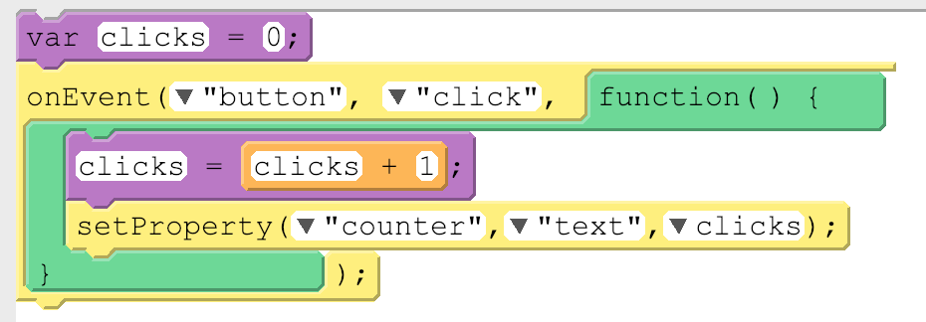
Unit 4 Lesson 10 - Activity
Global vs. Local Variables
There's two types of variables, global and local, and so far we've only used global variables. Here's the main difference between global and local variables.
Type of Variable | How It Works | How Created | Picture
Global | Permanent. Can be used anywhere in your code. | var used outside an onEvent()
Local | Temporary. Can be used only in the part of the code where it was created, like inside an onEvent(). Deleted once the onEvent() is done running. | var used inside an onEvent()

Slide 21
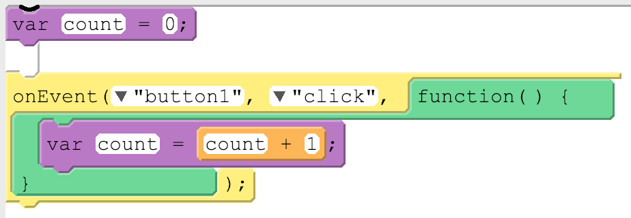
Unit 4 Lesson 10 - Activity
Avoiding Local Variables and Debugging
Local variables will eventually be useful but for now they're most likely to just be confusing. The biggest issue you'll fun into right now with local variables is accidentally using var inside of an onEvent() or function. Here's what the code usually looks like:
This code is pretty confusing. While it looks like there's only one variable being used, it actually has two variables, one local and one global, and they're both named count! Changing the value on one will have no impact on the other. This can cause unexpected behavior in your code and it can get tricky to debug.
The best way to avoid these issues is to make sure for now that you're not using var inside of an onEvent() or function. If you run into a tricky debugging problem, check if you're accidentally creating a local variable.

Slide 23
Unit 4 Lesson 10 - Wrap Up
Prompt:
What aspects of working with functions clicked today?
What do you still feel like you have trouble with?

Slide 24
Unit 4 - Lesson 11
Functions Make

Slide 27
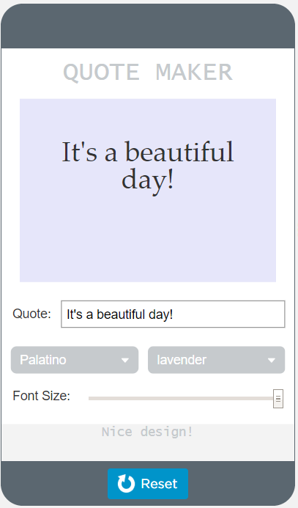
Unit 4 Lesson 11 - Activity
Functions Make:
Quote Maker App
Do This:
Navigate to Lesson 11, Level 1 on Code Studio

Slide 28
Unit 4 Lesson 11 - Activity
Do This:
Try many of the different options
Pay attention to what is happening on the screen when you move the slider or choose an item from the dropdown
When does the screen update?
What happens if you choose lavender and Lucinda Sans from the dropdowns? Try choosing lightgreen and moving the slider until you receive different feedback.
Prompts:
What does this app do?
What are the inputs?
What are the outputs?
How could a function be used in this app?

Slide 29
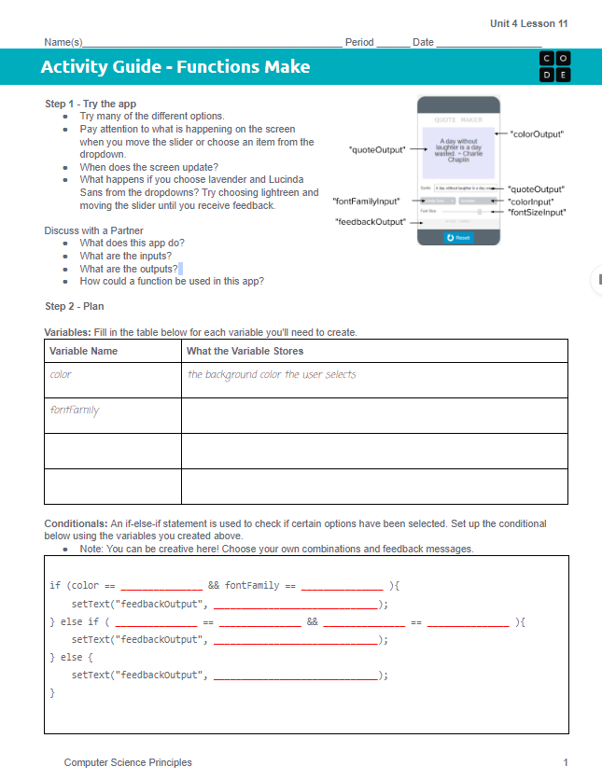
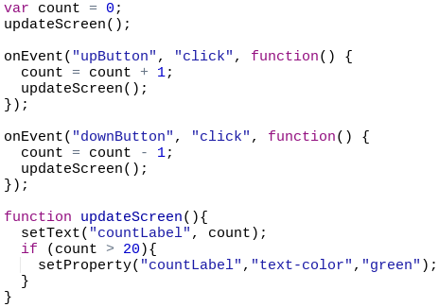
Unit 4 Lesson 11 - Activity
Do This: Make the Quote Maker!
The updateScreen() Pattern

Slide 30
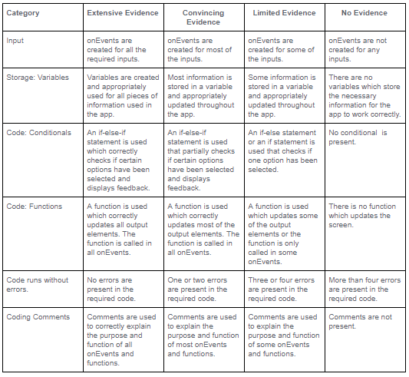
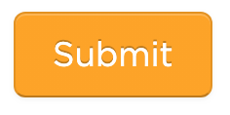
Unit 4 Lesson 11 - Activity
Don't forget to check the rubric before hitting submit!

Slide 32
Unit 4 Lesson 11 - Wrap Up
Great job today!

